Slide 1
Spiking Neural Network RTL Design and Verification Using System Verilog & UVM Methodology
By
Gaurang Brijbhushan Pandey
BITS ID : 2023HT80003 MTech Microelectronics 2023-25

Slide 2
Agenda
Introduction to AI & Machine Learning
Hardware vs. Software Implementation
Introduction to Spiking Neural Networks (SNNs)
SNN RTL Design Architecture
System Overview
Key Components
Verification Methodology using UVM
Testbench Architecture
Verification Components
Project Implementation & Results
Conclusion

Slide 3
Introduction to AI & Machine Learning
Artificial Intelligence: Systems that can perform tasks that typically require human intelligence
Problem-solving, pattern recognition, decision making
Revolutionary impact across industries
Machine Learning: Subset of AI focused on algorithms that improve through experience
Supervised, unsupervised, and reinforcement learning
Neural networks, deep learning, convolutional networks
Industry Growth: Expected to reach $407 billion by 2027
Exponential increase in AI applications
Growing computational demands

Slide 4
The AI Computational Challenge
Growing Model Complexity:
GPT-4: 1.76 trillion parameters
Increasing accuracy demands more compute power
Energy Consumption Concerns:
Training large models can emit as much carbon as 5 cars over their lifetime
Data centers account for 1-2% of global electricity use
Real-time Processing Requirements:
Edge computing demands low-latency solutions
Autonomous vehicles, medical devices need instant responses

Slide 5
Hardware vs. Software Implementation
Software Implementation
Advantages:
Flexibility and ease of development
Rapid prototyping and iteration
Lower initial investment
Limitations:
Performance overhead from general-purpose architecture
Power inefficiency
Serial processing bottlenecks
Hardware Implementation
Advantages:
10-100x performance improvement
Superior energy efficiency
Parallel processing capabilities
Lower latency for real-time applications
Limitations:
Expensive

Slide 6
Why Hardware Acceleration Matters
Performance Comparison
Real-world Impact: Tesla FSD Computer: 144 TOPS performance
Google TPU: 180 teraflops, 90x more efficient than CPUs
Neuromorphic chips: IBM TrueNorth - 1 million neurons with only 70mW power

Slide 7
Introduction to Spiking Neural Networks
Bio-inspired Computing:
Mimics biological neurons that communicate through discrete "spikes"
Event-driven computation
Key Features:
Temporal information processing
Energy efficiency through sparse activation
Asynchronous processing
Applications:
Edge computing devices
Pattern recognition
IoT solutions requiring low power

Slide 8
Project Scope and Objectives
Design a multi-layer SNN core at RTL level:
Spike-based computations
Synaptic weight updates
Multi-layer spike propagation
Develop UVM-based verification environment:
Functional correctness verification
Accurate inter-layer spike propagation
Measure performance metrics:
Correctness, Code coverage
Latency & Functional Coverage is not in the current scope
Explore real-world applications:
Pattern recognition
Low-power computation

Slide 9
SNN RTL Design: System Overview
Architecture Components:
Input layer that converts pixel values to spike trains
Hidden layer with configurable neurons
Output layer that produces classification results
Control and status registers (CSRs) via APB interface
Clock division and reset synchronization
Processing Model:
Binary spikes mimic biological neural networks
Event-driven computation

Slide 10
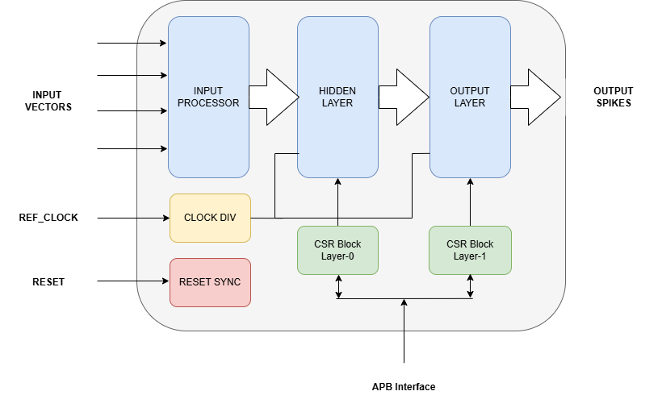
SNN Top-Level Architecture

Slide 11
SNN Components: Input Processor
Purpose:
Converts input values (0-255) into spike trains
Implements rate coding for neural inputs
Operation:
Uses counters to control spike generation timing
Computes dynamic thresholds based on pixel values
Generates output spikes when counters are below thresholds
Interface:
Clock and reset signals
Pixel value inputs
Generated spike train outputs

Slide 12
SNN Components: Leaky Integrate-and-Fire Neuron
Core Computational Unit:
Implements biological neuron behavior
Accumulates weighted spikes
Applies decay factor (leakage) – Not implemented in the current design
Fires when threshold is exceeded
Key Parameters:
Membrane potential (32-bit)
Configurable leak factor – No dedicated CSRs
Firing threshold – Programmable CSR
Reset behavior

Slide 13
SNN Components: Synapse Module
Function:
Spike-weight multiplication
Transmits weighted signals to neurons
Key for learning through weight adjustment
Programable CSRs for weight and spike threshold
Operation:
Accumulates weighted input spikes
Compares accumulated value to threshold
Generates output spikes when threshold exceeded
Resets after configurable spiking window

Slide 14
SNN Components: Neuron Layer
Structure:
Groups multiple LIF neurons & synapses
Forms functional network layer
Handles parallel spike processing
Feed OR-ed input (outputs from synapses) to the neurons
Connectivity:
Fully connected between inputs and neurons
Aggregates weighted spikes for each neuron
Produces output spikes from each layer

Slide 15
SNN Control: CSR and Interface
APB Interface:
External configuration access
Memory-mapped registers
Configurable Parameters:
Synaptic weights
Neuron thresholds
Spike thresholds
Control registers
Clock and Reset Management:
Clock divider for controlled timing
Reset synchronization across domains

Slide 16
Verification Strategy: UVM-Based Approach
Objective:
Verify SNN functional correctness
Ensure configuration flexibility
Validate spike propagation accuracy – Input to Output connectivity
Methodology:
Universal Verification Methodology (UVM)
Layered testbench architecture
Reusable verification components

Slide 17
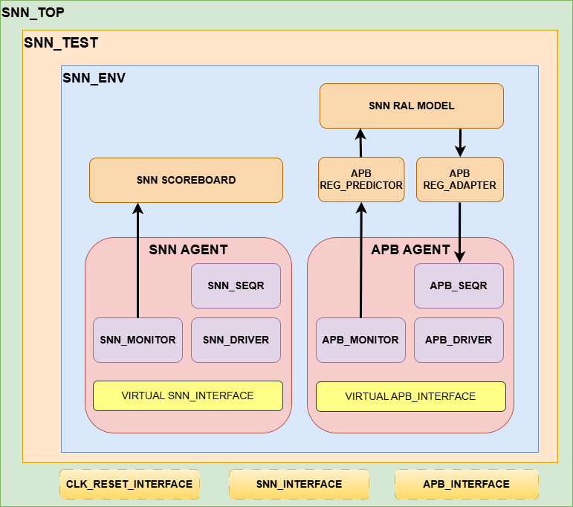
Verification Architecture

Slide 18
Verification Components: APB Agent
Purpose:
Drive APB-based CSR accesses
Configure SNN parameters
Components:
Transactions for address, data, control
Driver for bus operations
Monitor for tracking bus activity
Register model adapter and predictor

Slide 19
Verification Components: SNN Agent
Function:
Handle pixel input driving
Capture neuron spike outputs
Components:
Transactions for pixel data
Driver for 8-bit input array [64 indexes wide]
Monitor for spike output observation
Sequencer for coordinating test patterns

Slide 20
Verification: Register Model and Scoreboard
Register Abstraction Layer:
Models design registers and fields (UVM RAL Model)
Enables consistent access and verification (Register Write/Read APIs)
Front door and backdoor access support
Scoreboard:
Verifies output spike correctness
Compares expected vs. actual behavior

Slide 21
Verification: Test Scenarios
Stimulus Patterns:
Register bit-bash and random access
Random pixel values
Reset Scenario
Gradient and checkered patterns
Noise injection tests
Verification Focus:
Functional correctness
Reset behavior
Pattern recognition capability
Stability under varying inputs

Slide 22
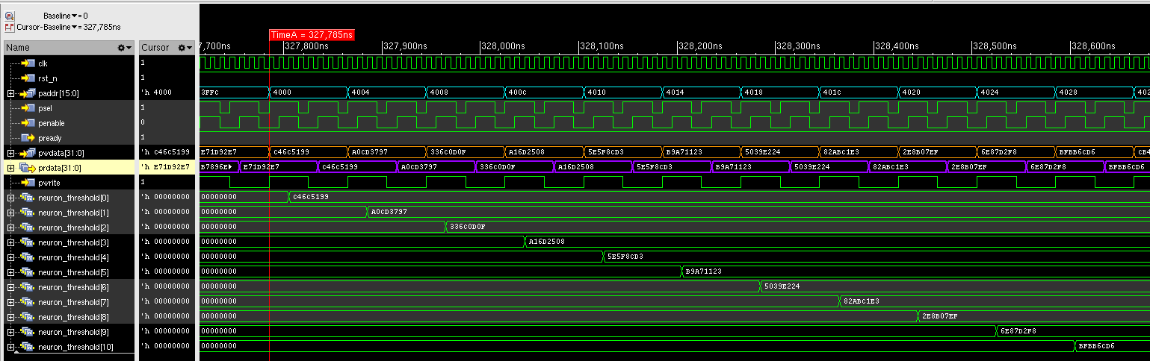
Verification: Waveform Snapshot
CSR WRITE READ OPERATION via APB

Slide 23
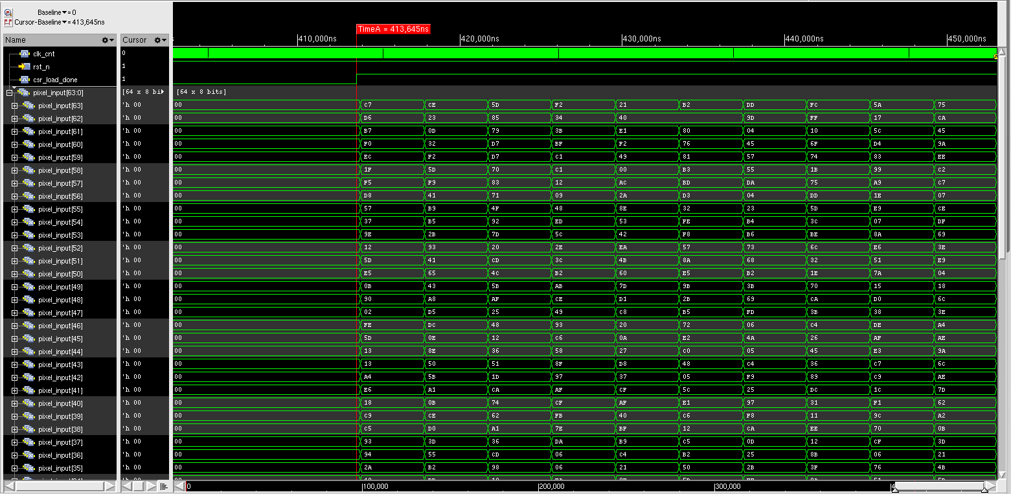
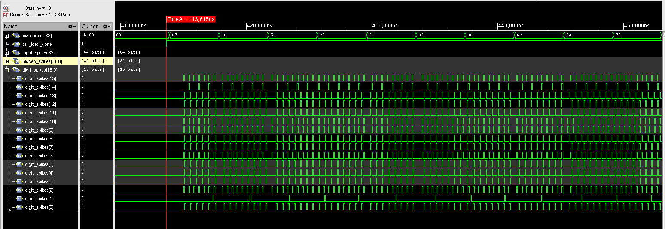
Verification: Waveform Snapshot
← INPUT - Drive Pixel Values
OUTPUT SPIKES →

Slide 24
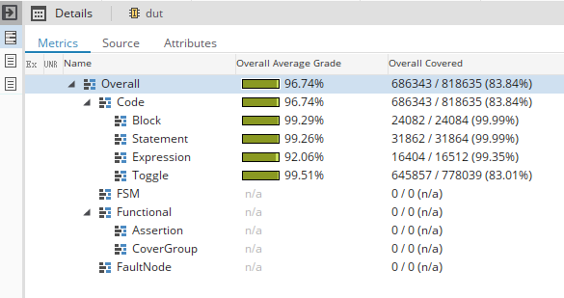
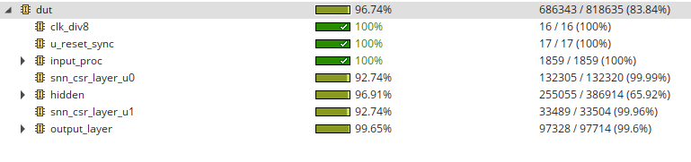
Verification: Code Coverage

Slide 25
Potential Applications & Future Work
Real-world Applications:
Energy-efficient edge computing
Pattern recognition in resource-constrained environments
Neuromorphic sensor processing
Autonomous systems
Future Extensions:
Multi-core SNN scaling
Hardware optimization for FPGA/ASIC
Integration with sensor interfaces
Functional Coverage and Power Consumption
Netlist to GDS II flow

Slide 26
Conclusion
Successfully designed and verified a configurable SNN in SystemVerilog RTL
Implemented bio-inspired neuromorphic computation with hardware efficiency
Created robust verification methodology using UVM
Demonstrated potential for real-world neuromorphic computing applications
Established foundation for future hardware-based AI acceleration research

Slide 27
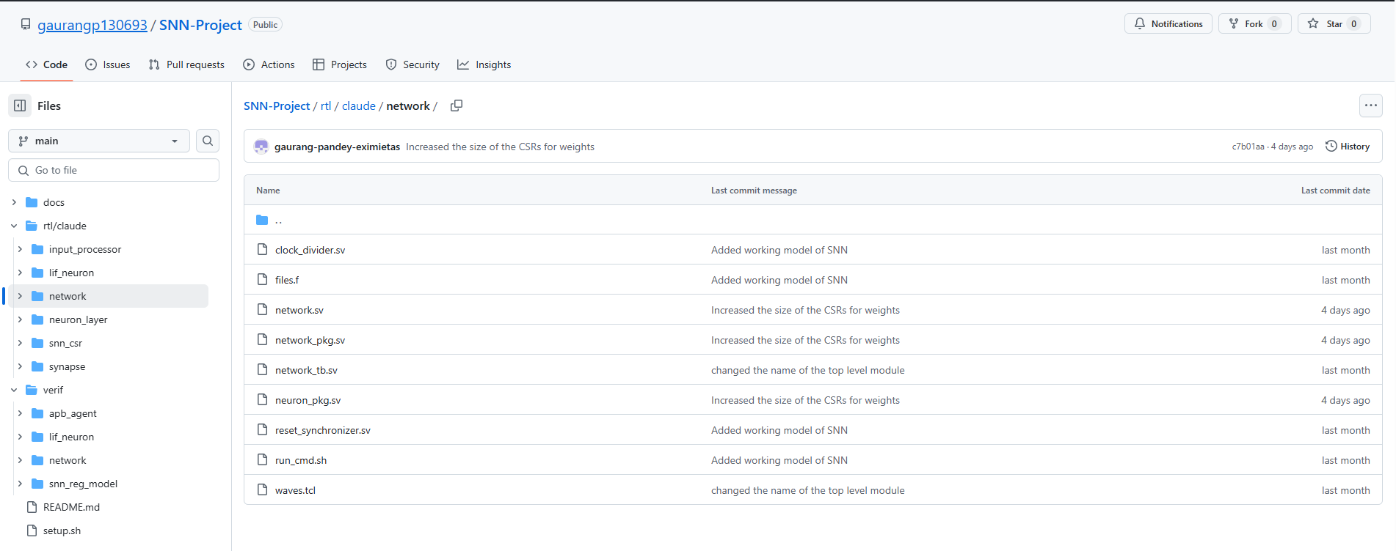
GitHub Repository: https://github.com/gaurangp130693/SNN-Project

Slide 28
Thank You
Dissertation by: Gaurang Brijbhushan Pandey
BITS ID: 2023HT80003
Degree Program: M Tech (Microelectronics)
Supervisor: Kishan Kalavadiya

